Slide 1

Norms
Ask questions
Engage fully
Integrate new information
Open your mind to diverse views
Utilize what you learn
Used with permission of Learning Forward, www.learningforward.org. All rights reserved.

Slide 2

What Is AVID?
  …A structured college preparatory system working directly with schools and districts
  …A direct support structure for first-generation college-goers, grades 4-16
  …A schoolwide approach to curriculum and rigor

Slide 3

8

Slide 4
The AVID Elective Student Profile
Has academic potential:
  Average to high test scores
  2.0-3.5 GPA
  College potential with support
  Desire and determination

Slide 5

The AVID Elective Student Profile
Meets one or more of the following criteria:
  First to attend college
  Historically underserved in four-year colleges
  Low income
  Special circumstances

Slide 6
A Sample Week in the AVID Elective:
Daily or Block Schedule
A Sample Week in the AVID Elective
Monday | Tuesday | Wednesday | Thursday | Friday
AVID Curriculum | Tutorials | AVID Curriculum | Tutorials | Binder Evaluation Field Trips Media Center Speakers Motivational Activities (within block)
Combination for Block Schedule |  | Combination for Block schedule
Curriculum:
Writing
College and Careers
Strategies for Success
Critical Reading
Tutorials:
Collaborative Study Groups
Writing Groups
Socratic Seminars

Slide 7

WICOR: Writing
  Writing process (prewrite to final draft)
  Respond, revise
  Edit, final draft
  Cornell notes
  Quickwrites
  Learning logs, journals

Slide 8

WICOR: Inquiry
  Skilled questioning
  Socratic Seminars
  Quickwrites/discussions
  Critical thinking activities
  Writing questions
  Open-minded activities

Slide 9

WICOR: Collaboration
  Group projects
  Response/edit/revision groups
  Collaboration activities
  Tutorials
  Study groups
  Jigsaw activities
  Read-arounds

Slide 10

WICOR: Organization
Tools
Binders
Calendars, planners, agendas
Graphic organizers
Methods
Focused note-taking system
Tutorials, study groups
Project planning, SMART goals

Slide 11

WICOR: Reading
  SQ5R (Survey, Question, Read, Record, Recite, Review, Reflect)
  KWL (What I Know; What I Want to Learn; What I Learned)
  Reciprocal teaching
  “Think-alouds”
  Text structure
  Critical reading

Slide 12
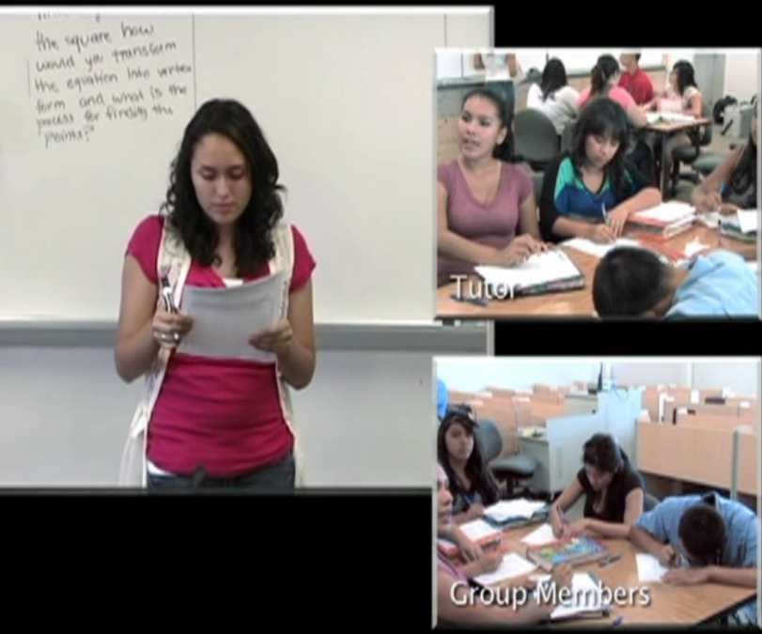
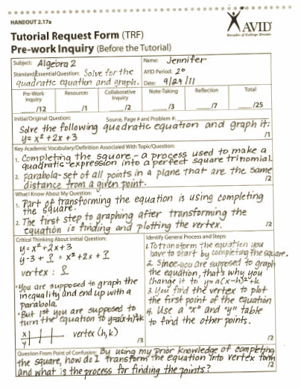
Jennifer’s Tutorial Video
Pg. 7-8

Slide 13
The Tutorial Process
Why do we do Socratic tutorials in AVID?
To prepare AVID students for success in their current classes, as well as building the skills necessary to be ready for college.
Notes:
‹#›

Slide 14
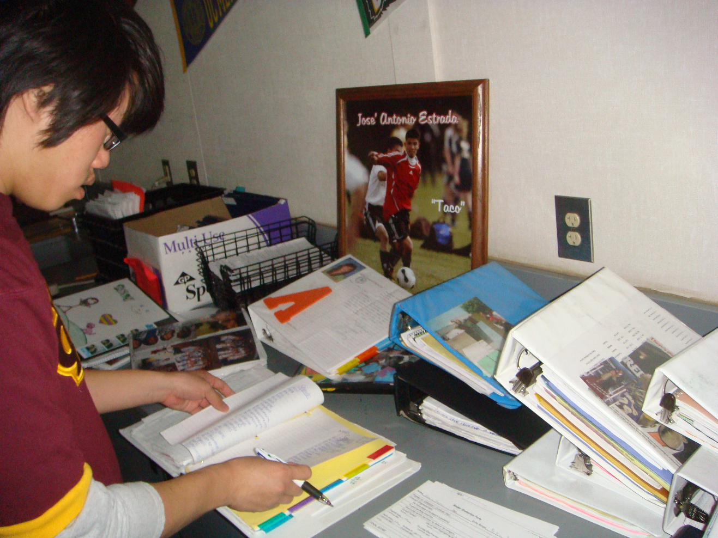
Binder Briefing
(Highly successful people are organized.)
Pg. 9-10

Slide 15
The CORNELL WAY
The College-Readiness Skill of Focused Note-Taking
Pg. 11

Slide 16
Our Essential Question:
CORNELL NOTES | TOPIC/OBJECTIVE: | NAME:
 |  | CLASS/PERIOD:
 |  | DATE:
ESSENTIAL QUESTION: How should tutors aid students in the process of learning how to take effective notes?

Slide 17
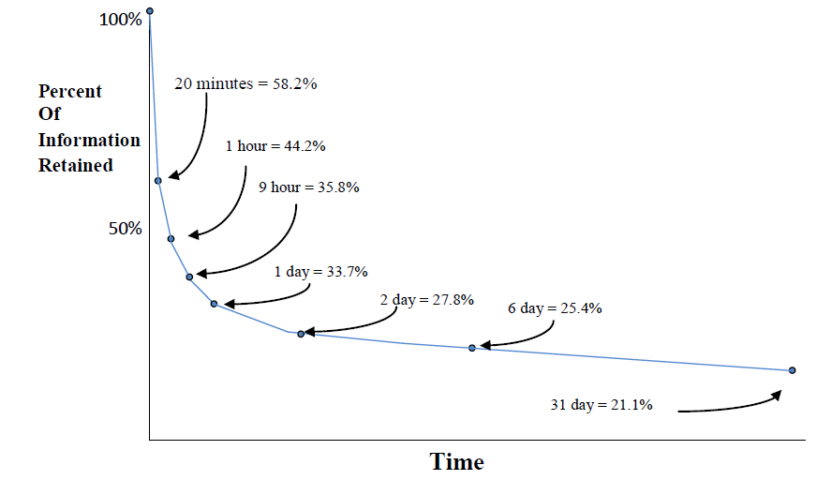
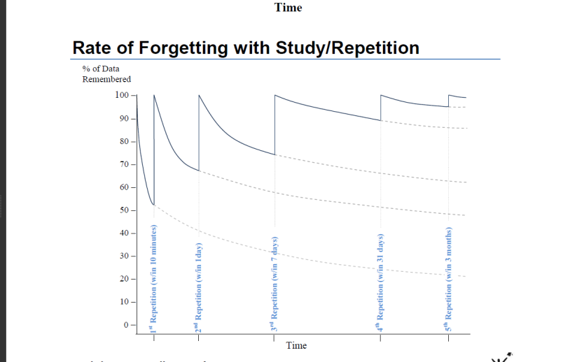
Why Does Structured Note-Taking Matter?

Slide 18
Four Elements of Cornell Notes
Note-Taking
  Creating the format of your notes
  Organizing your notes
Note-Making
  Reviewing and revising the content of the notes
  Noting key chunks of material in the notes
  Exchanging ideas and collaborating
  about the material
Pg. 44

Slide 19
Four Elements of Cornell Notes
Note-Interacting
  Link all the learning together by writing a summary
  Learn from your notes by studying them!
Note-Reflecting
  Written feedback from a peer, tutor, or teacher
  Address the feedback by focusing on one area of challenge
  Your reflection over an entire unit and how your notes helped you learn and retain information

Slide 20

Note-Taking
Make sure that all notes taken and used in tutorials follow the Cornell note process.
Help students learn note-taking conventions.

Slide 21
Note-Making
Help students learn to “chunk” their notes accurately and effectively.
Support the writing and refining of higher-level questions in the left column.
If possible, attend a content-area class with the students, take notes, and then compare your notes to theirs.

Slide 22

Note-Interacting
Have students read the summary from their notes out loud to the group as the group provides feedback.
Constantly ask students, “Have you been studying from your Cornell notes?”

Slide 23
Note-Reflecting
Check for the quality and quantity of Cornell notes during binder checks, especially for students struggling in specific classes.
Ask students what aspect of Cornell notes they’re working on this week from their “Cornell Note Focused Goal Activity.”

Slide 24
CORNELL WAY
Find an elbow partner to compare notes.
“Chunk” your notes.
Write a question in the left column that covers the material in the corresponding “chunk.”
Share your questions with your elbow partner.
Write a summary in the bottom section that addresses the Essential Question and each of the questions that they wrote.

Slide 25
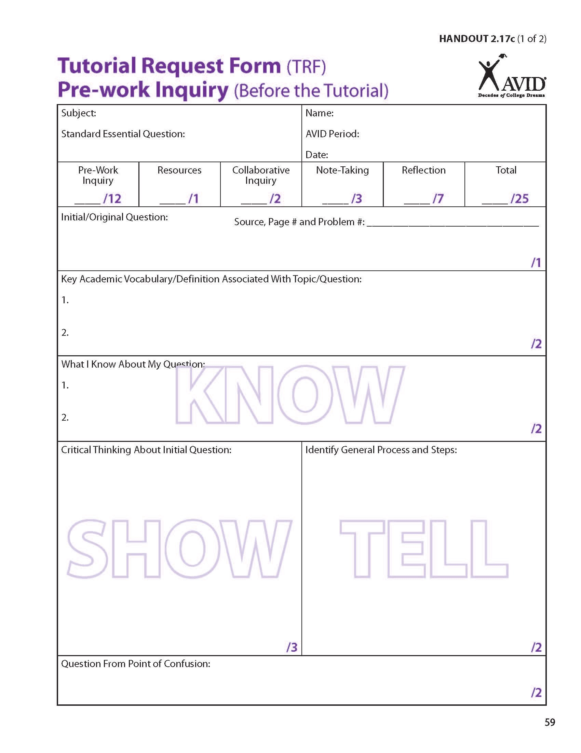
Before the Tutorial
Pg. 14

Slide 26
Where is Inquiry in the Tutorial Process?
Step 1:
In their academic classes, students take Cornell notes on the material presented in lectures, textbook readings, videos, handouts, etc.
After class, students review their notes, interact with their notes, create questions in the column on the left, and write a summary at the bottom of the notes.

Slide 27
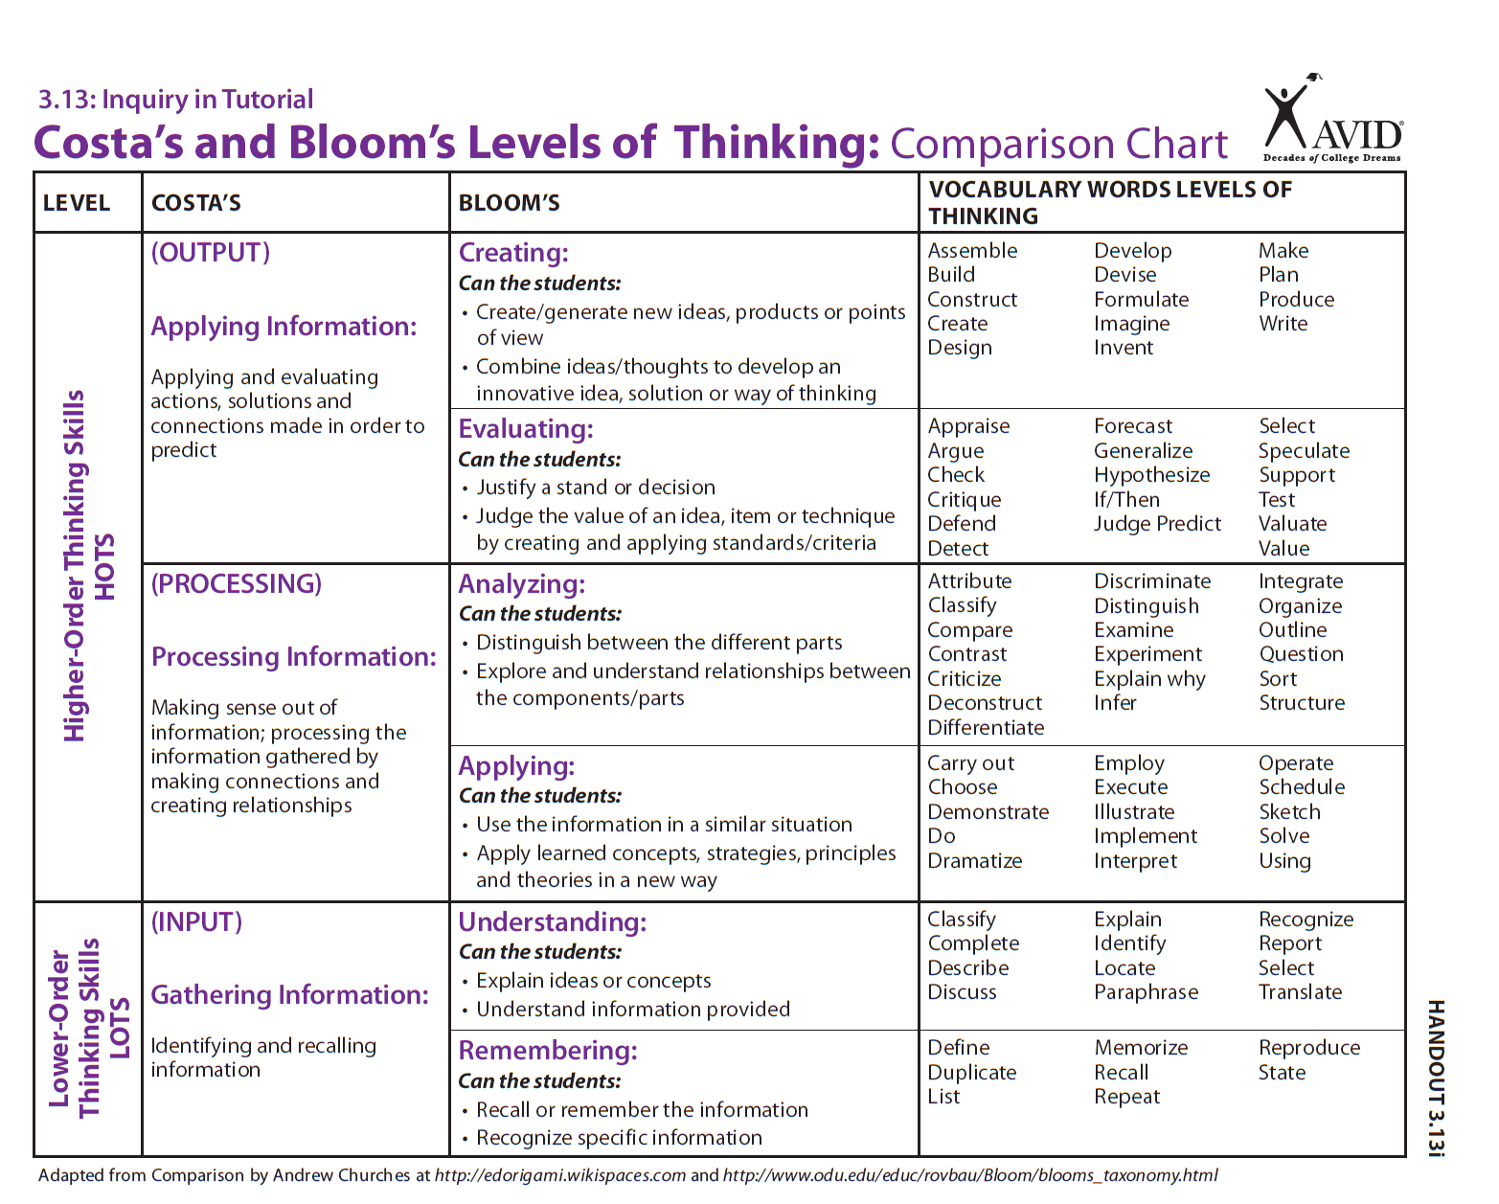
Pg. 17

Slide 28
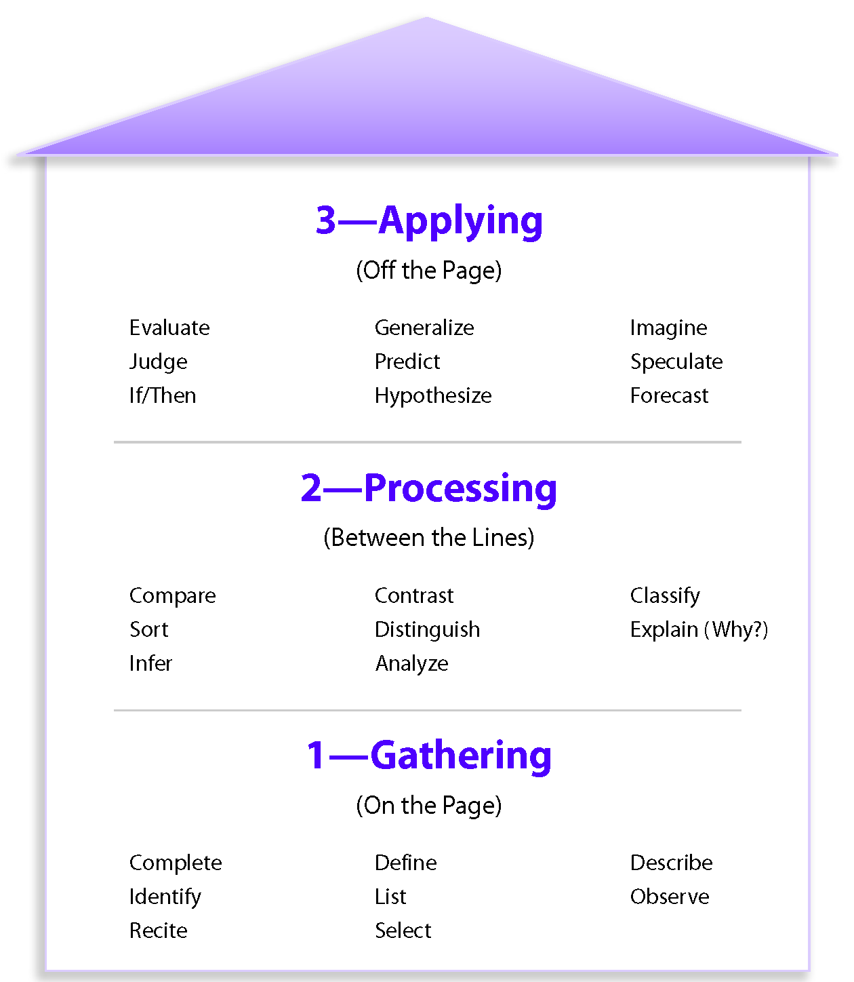
Costa’s Levels of Thinking

Slide 29
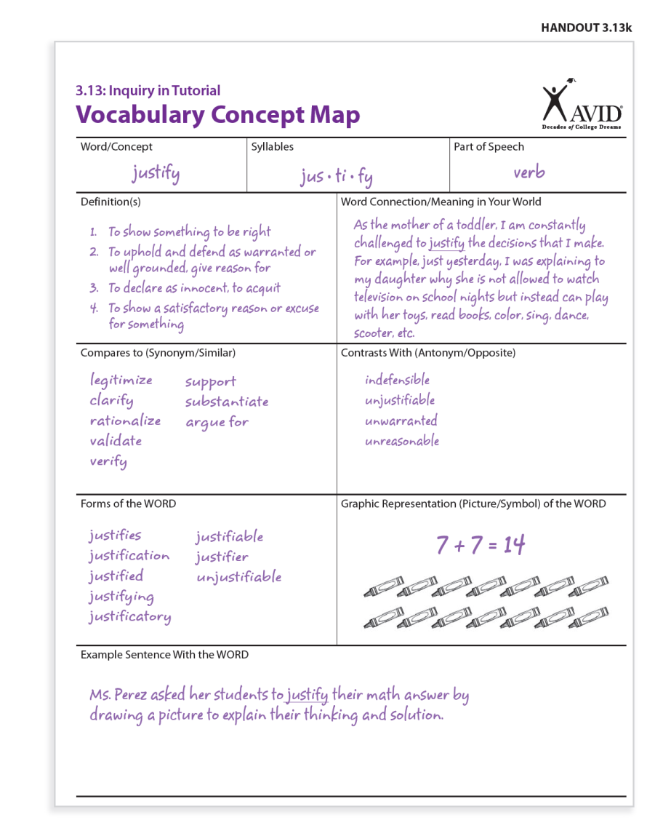
Vocabulary Concept Map
Pg. 18-19

Slide 30
Preparing for Tutorials
Room Arrangement:
Desks/chairs are in a half-circle
(horseshoe) next to the board.
Dividing into Groups:
Discuss how groups are formed.
Pg. 23

Slide 31
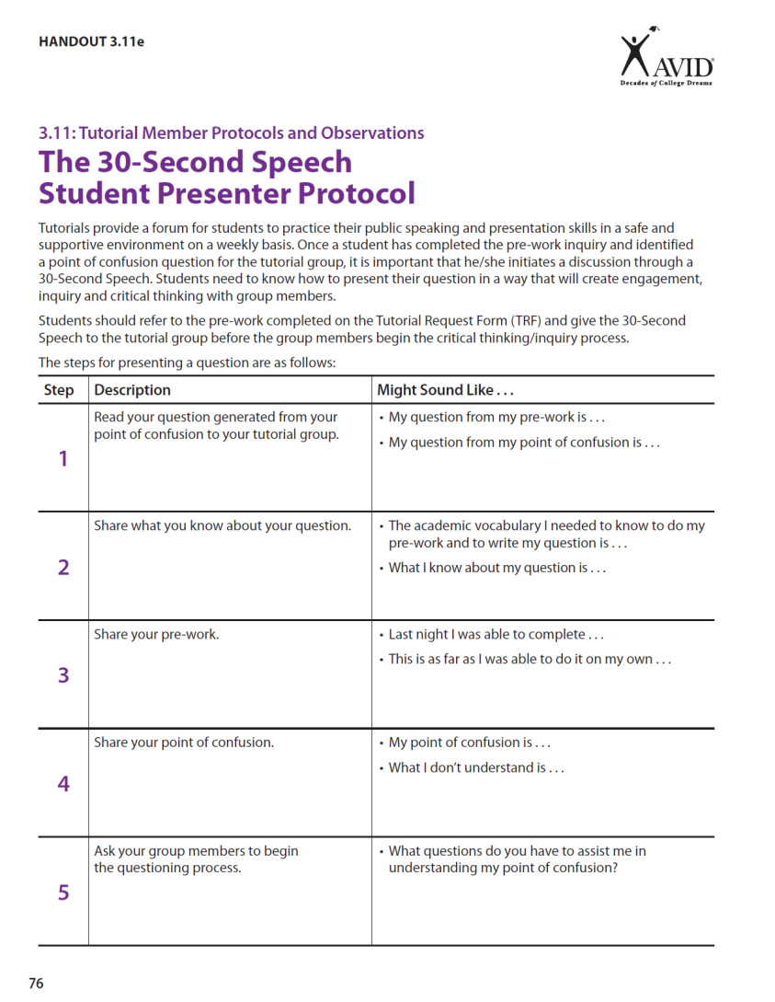
During the Tutorial
Pg. 25

Slide 32
Debrief
Which step of the 30-Second Speech was easiest for you as the tutor to coach?
Which step was the most difficult to coach?
If an AVID student were to ask you the purpose behind the 30-Second Speech, how would you respond?
Where might the 30-Second Speech be applicable in a college setting?

Slide 33

30-Second Speech
Prompt:
“What have you learned about setting up for and beginning a tutorial?”
Pg. 25

Slide 34
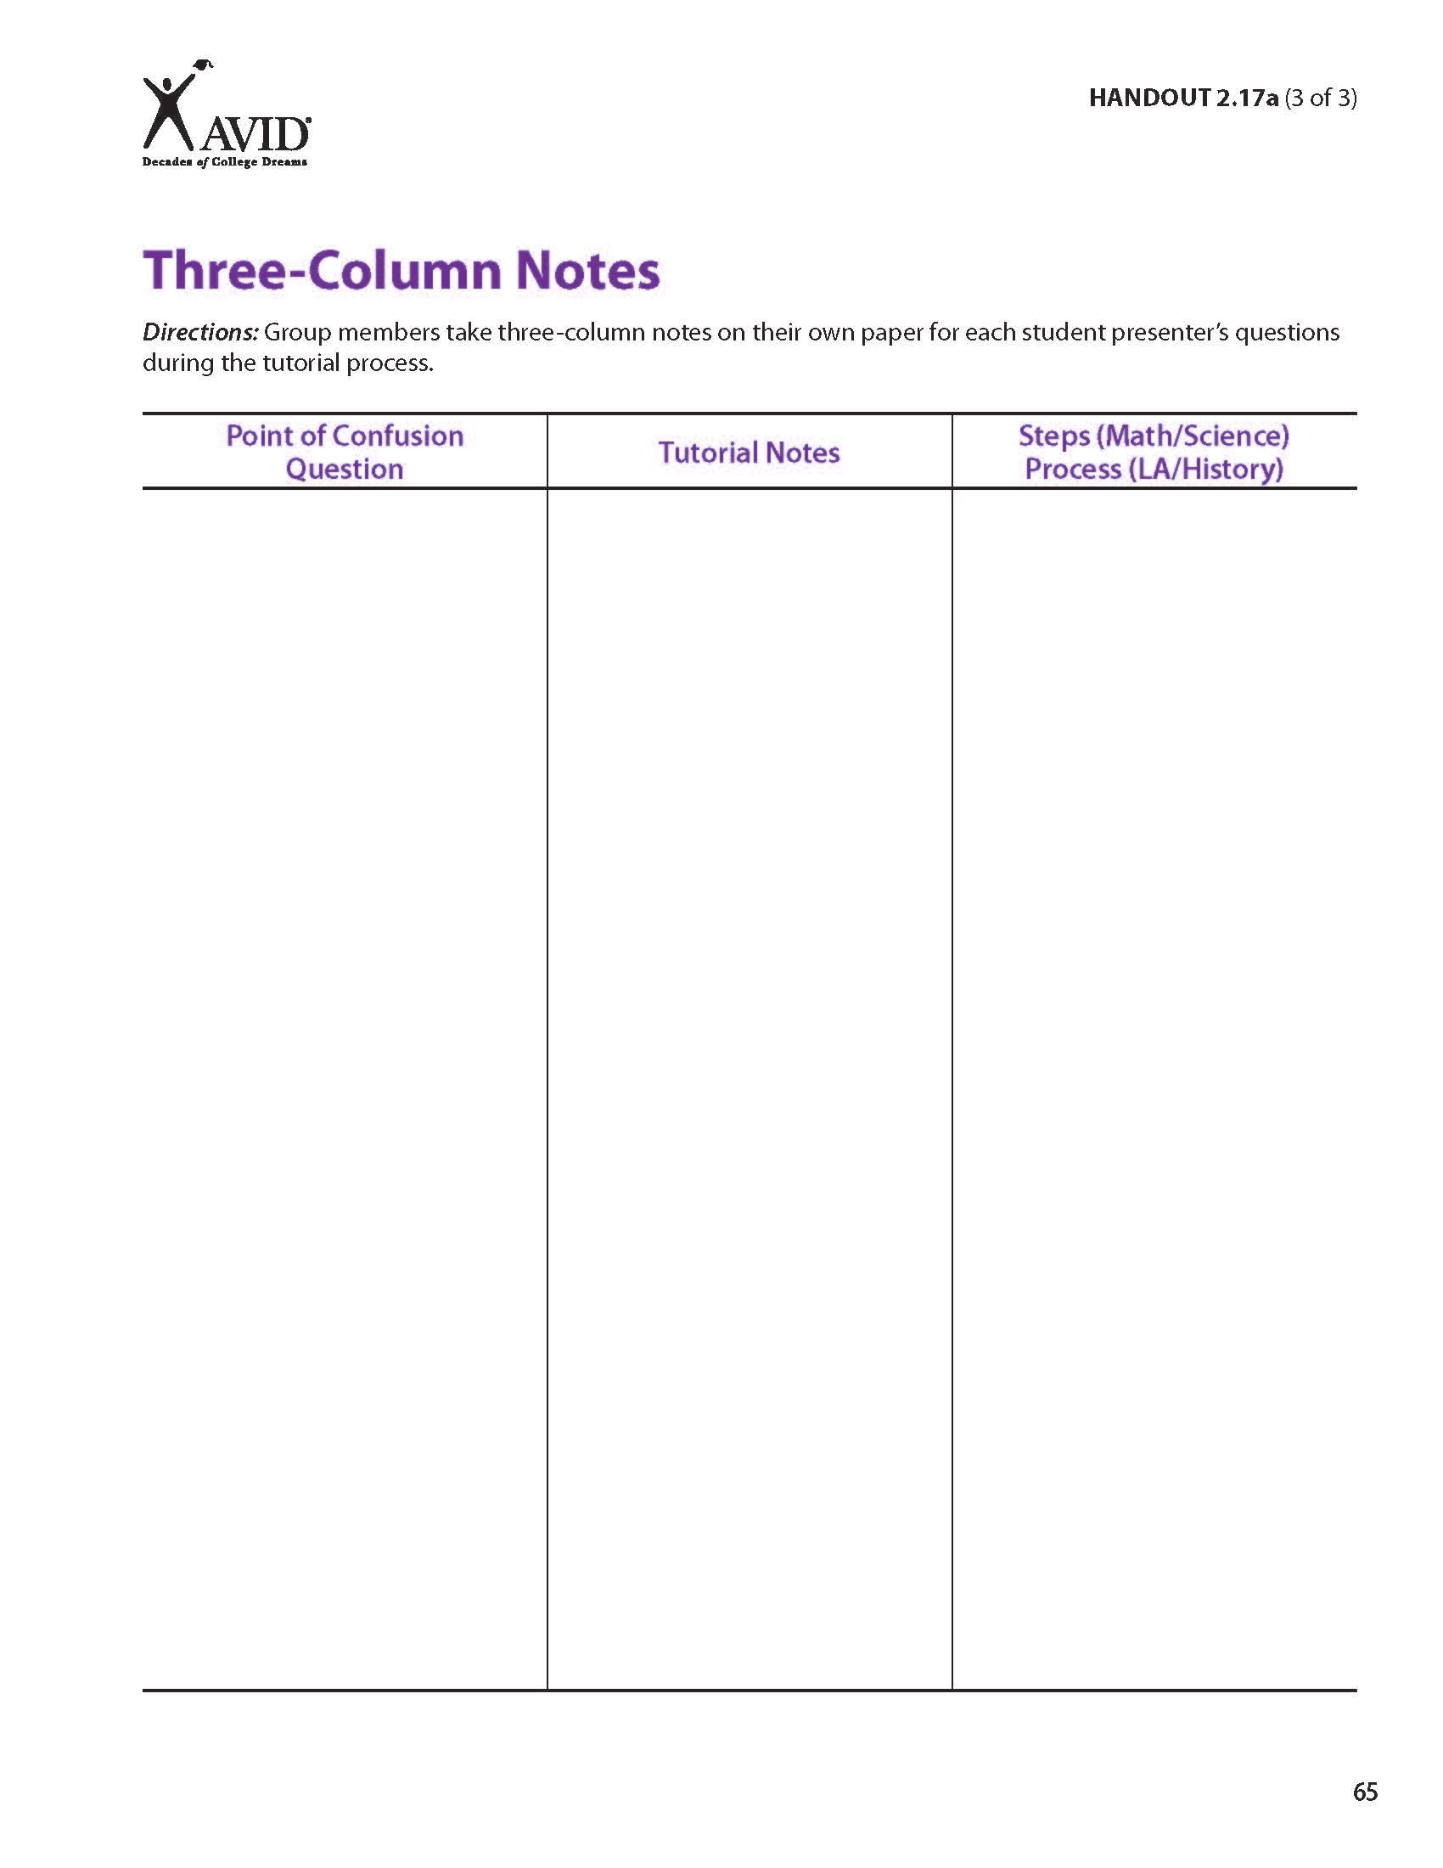
It’s All about the Process!
Pg. 29

Slide 35
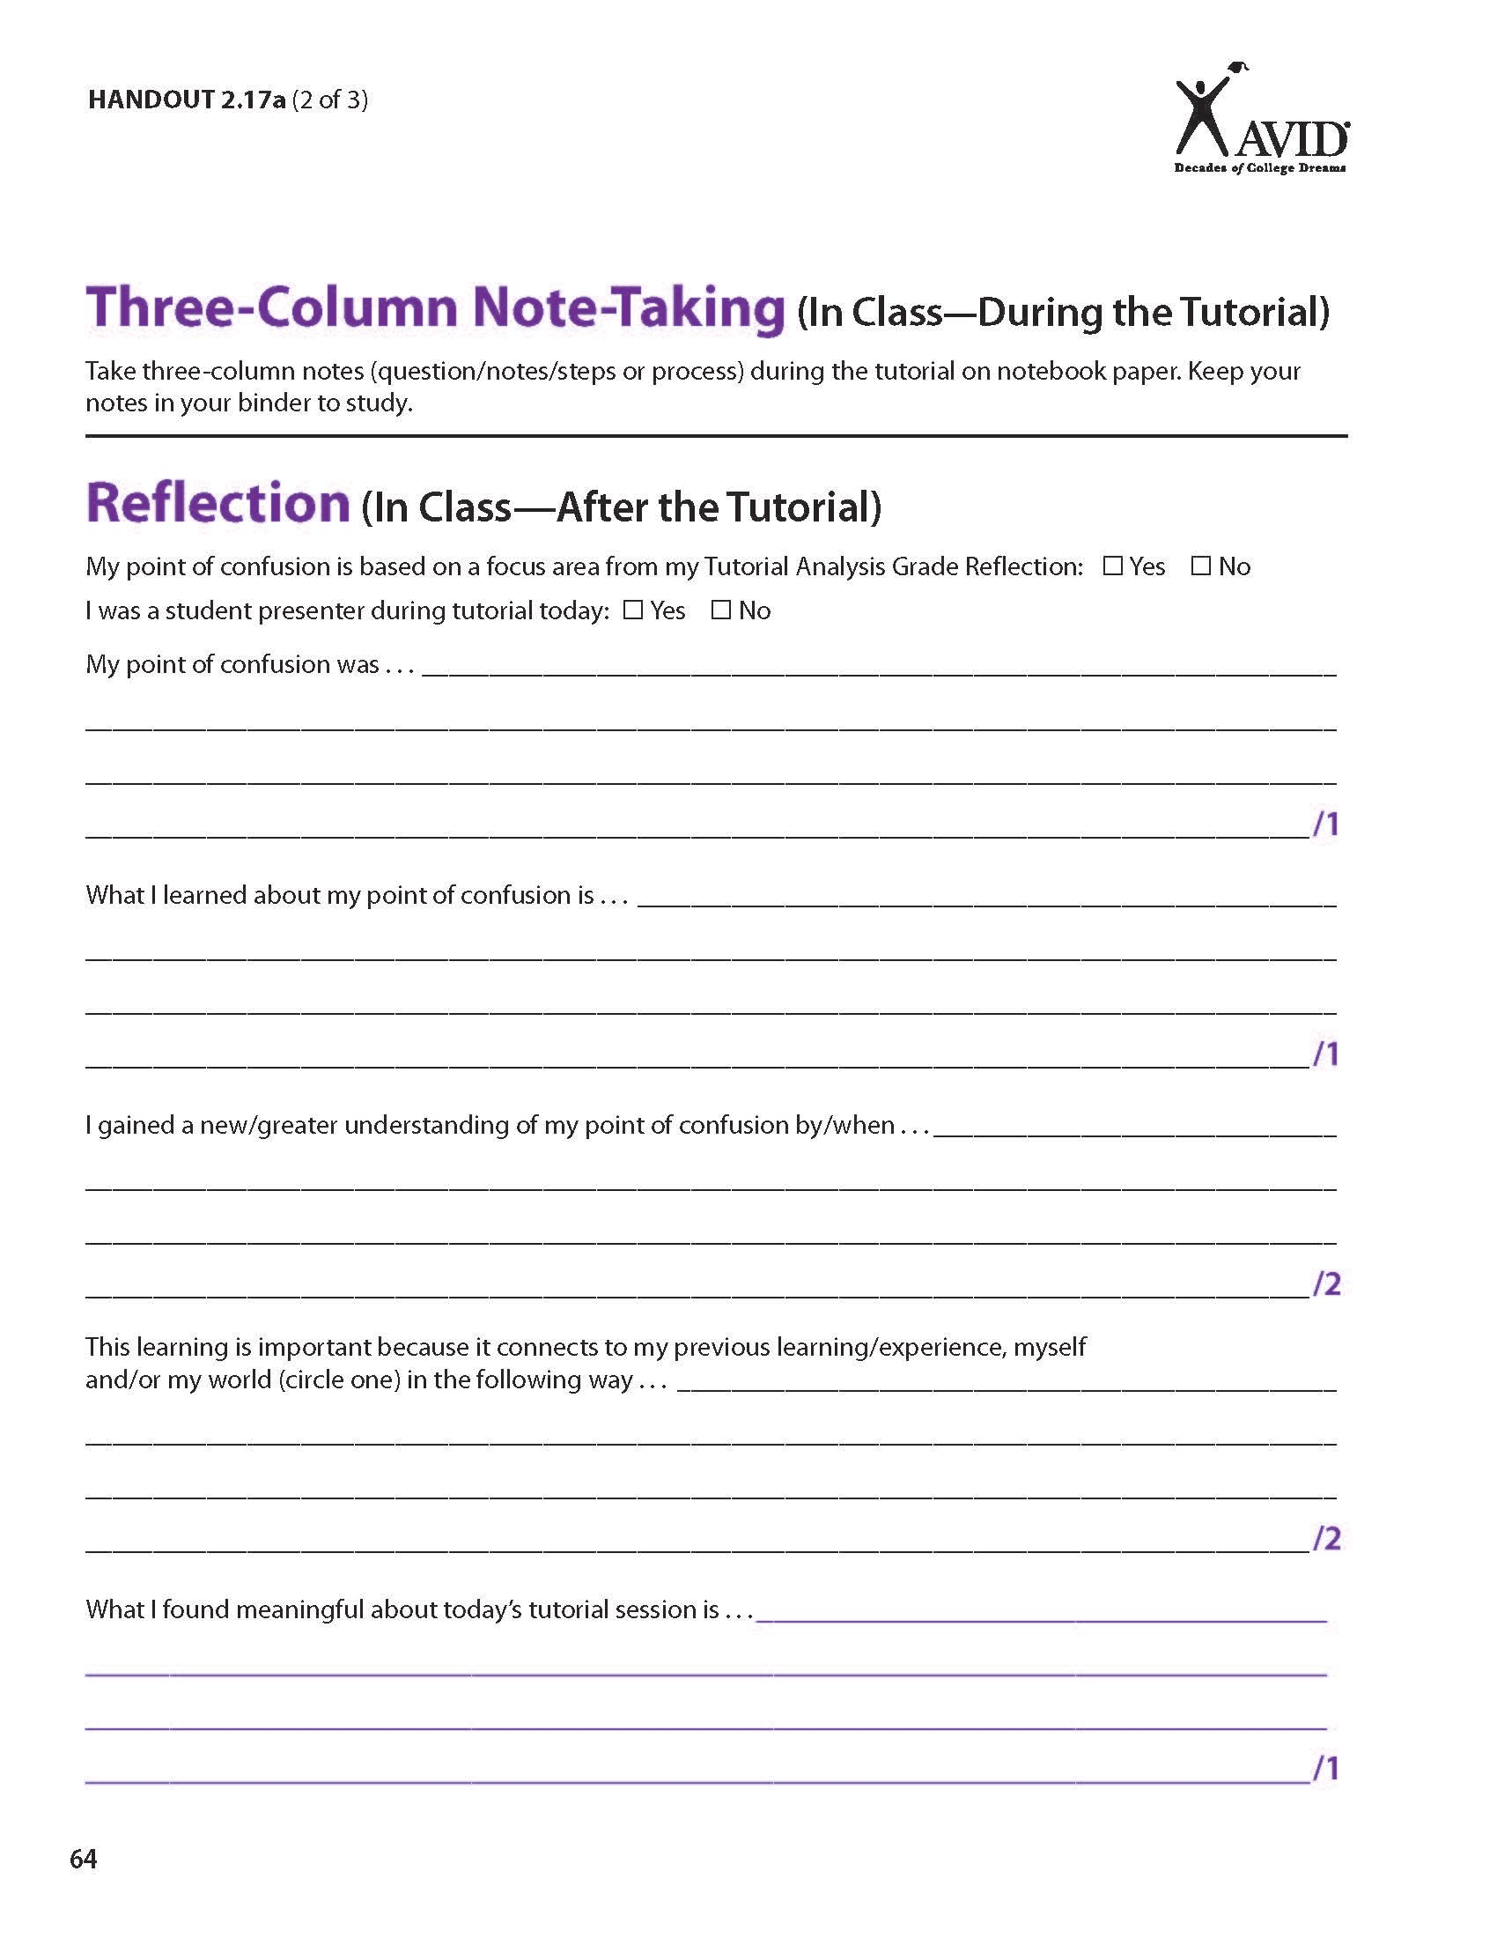
Reflection
What learning took place?
What is the relevance?
Pg. 34

Slide 36

WICOR-izing Tutorials
Pg. 35

